Slide 1
401k After Tax
Instructions for enrolling and FAQ
Eligibility beginning 1/1/2018

Slide 2
What is “After-Tax?”
After Tax is a vehicle in which you can use payroll contributions to fund your 401k to exceed the standard qualified deferral amount.
For 2018, the total max contributions for 401k is $55,000 – between deferrals (pre-tax and Roth), after-tax, and match. Typically, employees can defer $18,500 in 2018 in the form of pre-tax and/or Roth contributions. (Catch-up contributions $6,000 are extra and are on top of both amounts).
Any other amounts deferred via the After-Tax contribution are not eligible for match nor are they available for hardship withdrawal, however, they may be distributed at anytime. If you take a distribution before age 59 ½, you will be subject to any applicable income tax penalties on the growth of the after-tax contributions.
There are some options for converting these funds into your Roth 401k. Fidelity can explain how this works.

Slide 3
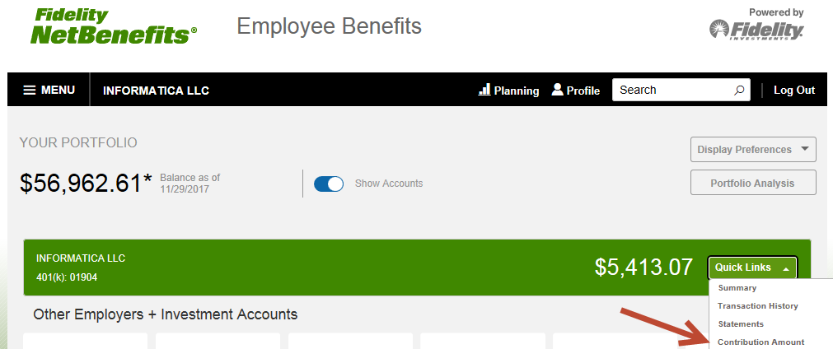
After Login to Fidelity NetBenefits
From the Quick Links menu, select Contribution Amount option.

Slide 4
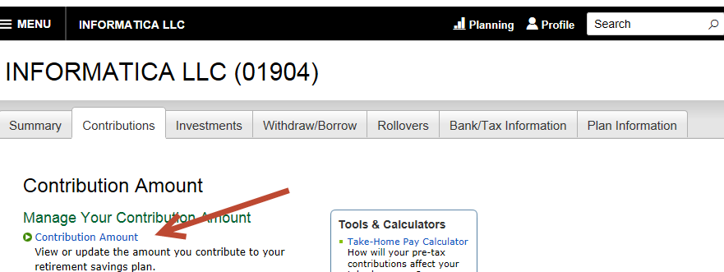
From the Contributions Tab.
Select Contributions Amount

Slide 5
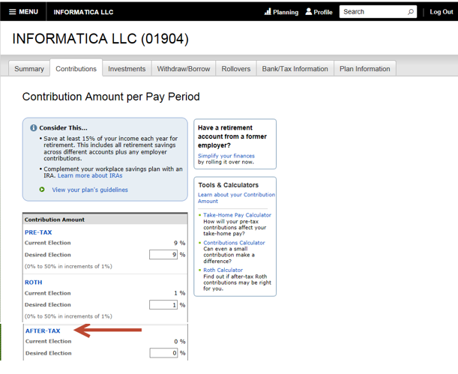
From the Contributions Tab – Contributions Amount per Pay Period
This page will show you your current elections and you can modify the percentages for Pre, Roth, and After-Tax.
Keep in mind, all deductions can run concurrently.

Slide 6
401k After-Tax Frequently Asked Questions
Does Informatica match After-Tax Deductions?
No. Informatica will only match up to $5000 of Pre-Tax or Roth contributions in 2018.
How much money can I contribute to After-Tax Deductions?
You can contribute a total contribution to your 401(k) plan for 2018 of $55,000. This includes the $18,500 Pre-tax/Roth limit, and the company match received, and any after-tax contributions, not including the $6000 catch up contributions for employees aged 50 and older.
For example: $18,500 in regular 401(k) contributions; $5000 in Company match = $23,500. Total Contributions $55,000 - $23,500 = $31,500. For those 50+ can also contribute $6000 in addition.
Can I convert my after-tax contributions to a Roth 401k?
Yes. You can convert your after-tax contributions into the Roth 401(k) within the plan.
How do I find out more about converting over the after-tax contributions?
Contact Fidelity at (800) 835-5097
Notes:
1. https://www.irs.gov/retirement-plans/rollovers-of-after-tax-contributions-in-retirement-plans

